Slide 1
html tags
MCNDHS
Ms. Eng

Slide 2
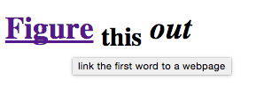
aim: how do we create images as links?
Do now:
step 1: codepen.io
step2:
Daily Grade:
On-time/attendance/not leaving the classroom: 25%
Cellphones: 25%
Notes:25%
Classwork/Homework: 25%

Slide 3
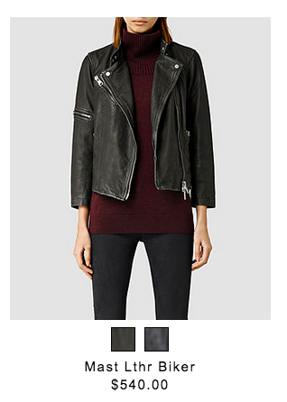

where you see it?

Slide 4
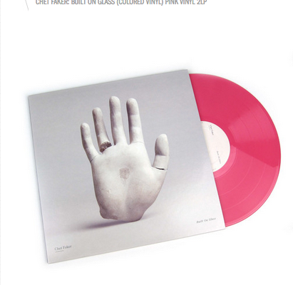

where else do you see it

Slide 5
image tag:
<img src=“insert the hyperlink of your image” alt=“write words if its broken” width=“pixels” height=“pixels”>
****No closing tag because you are not adjusting text!

Slide 6
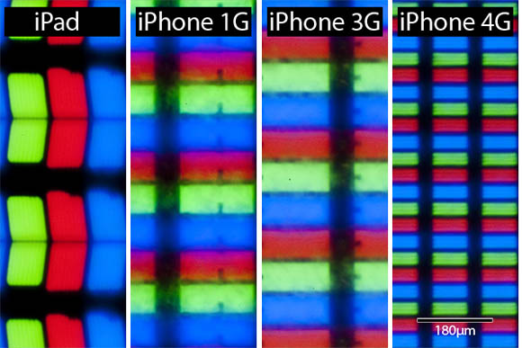
pixels

Slide 7
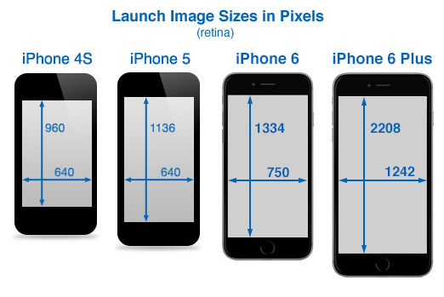
on your phone

Slide 8
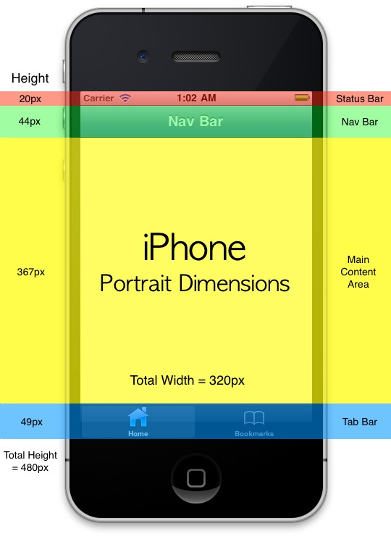
a closer look

Slide 9
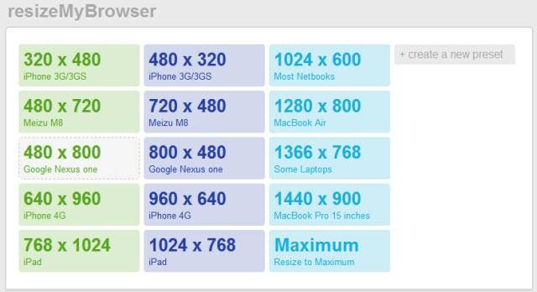
browser

Slide 10
Step by step
Step 1: Link tag
Step 2: Image tag
Step 3: closing link tag

Slide 11
logic behind what you are doing
What ever is in between the link tag will become a link
link tag

Slide 12

activity
create three images with the following format:

